Slide 1


Web and Social Media Analytics
Presented by: Anuj Aggarwal, Aishwarya Pradeep & Suresh Sable

Slide 2
Overview Background
Objective
Key Findings
Recommendation Appendix
Agenda

Slide 3




Overview
Finding Strategies To Add More Value For The Brand By Providing Most In Demand Features To The Customers

Slide 4



Background
As the firm has just entered the mobile market three years ago, they want to understand their competitors and preference of their users, so that they can design their strategies accordingly.

Slide 5



Objectives
To Provide major insights for a cell phone industry to help them develop a new product optimally.
To tweak the marketing strategies in order to add more value to the product and close the supply- demand gap.

Slide 6

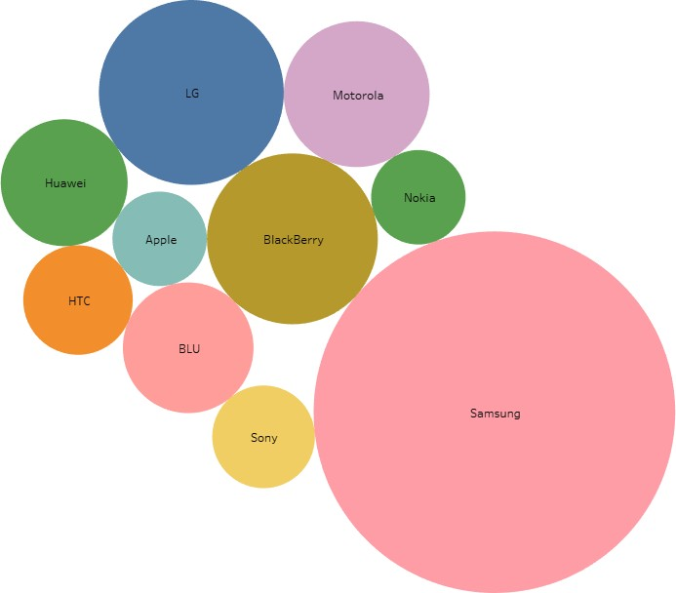
Most Popular Brands
Samsung, LG, BlackBerry and Motorola are some of the most popular brands. Here, popularity is based on number of reviews.
Since now we know how the market is controlled by these competitors, we can focus on the features and services provided by these brands.

Slide 7
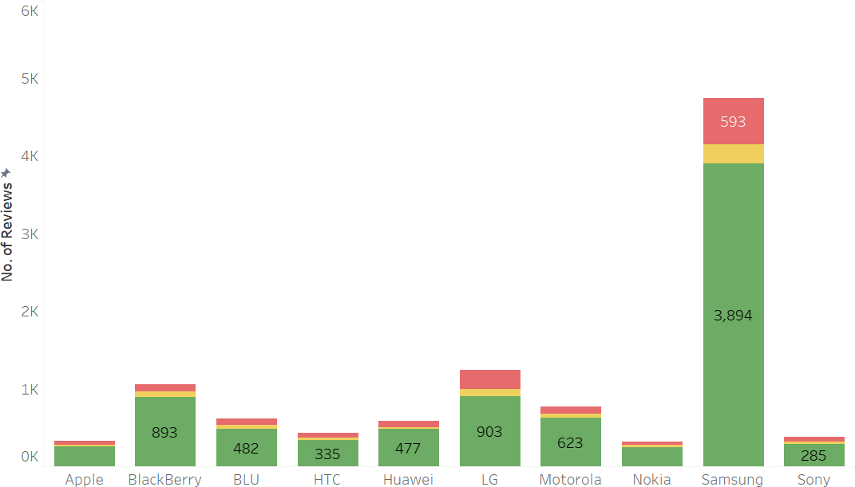

Top reviewed brands V/S overall rating
Looking at the top most reviewed brands, positive rating is more in all of them.
Samsung & LG have significant number of negative reviews as well. So we need to look at the features that were not liked by the customers for these brands.

Slide 8
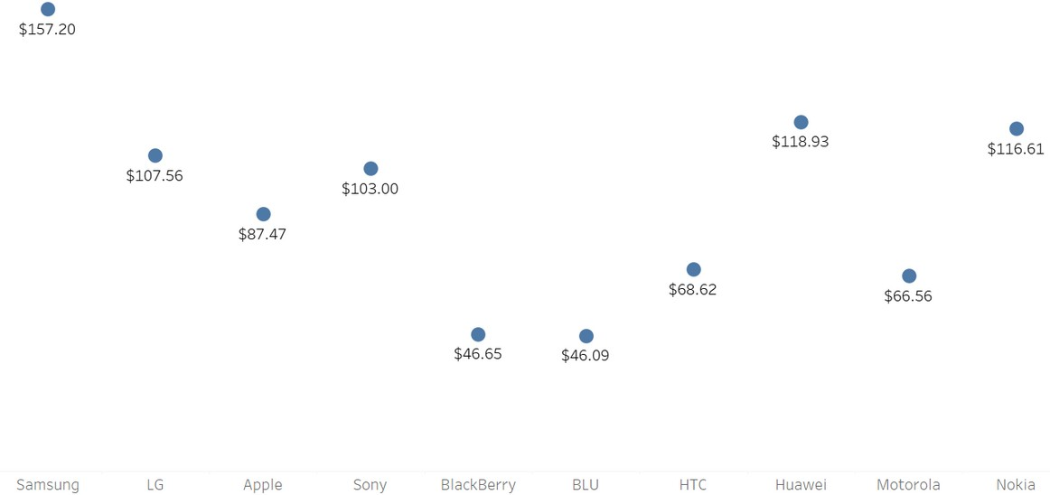
Top Brands & Average price
Some of the most popular brands like Samsung, LG and Sony have an average price of $80 - $160.
This price range could be afforded by most people and should be considered for sales

Slide 9
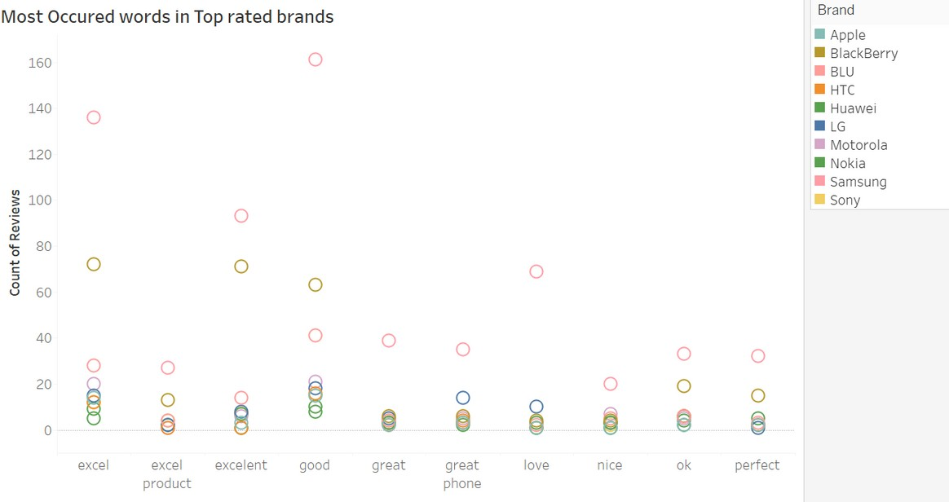

Most Occured words in Top rated brands
Good, excel & great are some of the most occurred words in the reviews of top rated brands.
Samsung & Blackberry have these words occurring in higher ration that other brands. This just implies that these brands are loved by the customers.

Slide 10

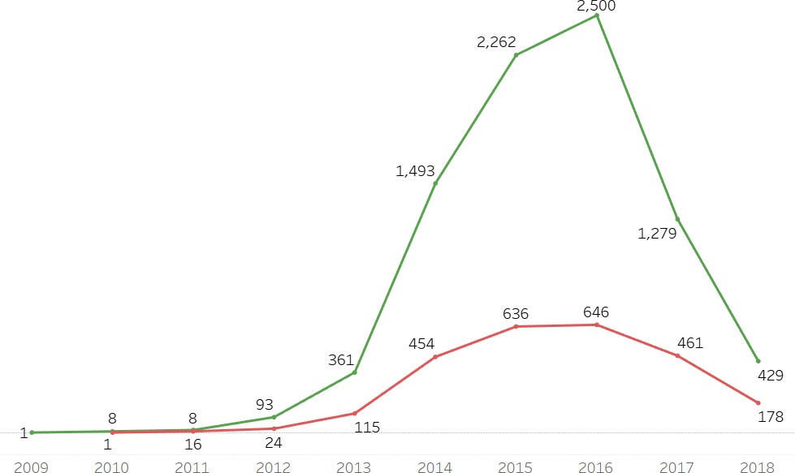
Review sentiments over the years
2014, 2015 & 2016 are some of the years where customers have provided most reviews.
The number of positive reviews are extremely high in 2016 which means brands must have launched some amazing features that attracted a lot of customes.

Slide 11

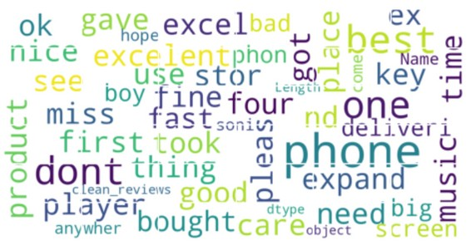
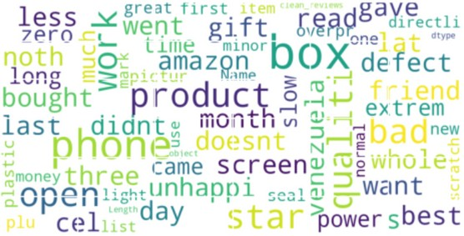
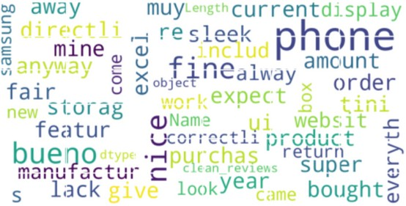

Word clouds and ratings
Common words in Positive reviews
Some of the most occurred words in positive reviews are best, excellent, phone & excel
Common words in Negative reviews
Some of the most occurred words in negative reviews are bad, box, doesn't, phone etc.
Common words in Neutral reviews
Some of the most occurred words in neutral reviews are phone, fine, nice etc.

Slide 12
Recommedations
Since now we know our competitors include brands like Samsung, LG, BlackBerry and Motorola; we have to keep a keen eye on the services and features offered by them.
We should also focus on the new features released in 2015 & 2016 as it attracted a lot of customers.
The market we are focusing on is a mid range price segment market since the price range preferred is in the range of $80-$160. This gives us the segment we need to focus and introduce our range of products in.
We have to focus on Keywords like good, great & excel for socially optimizing & make our brand popular in market.

Slide 13


Methodology
Performed cleaning, pre-processing of data.
Done text analytics with NLP to review the customer
Sentiment. Building search engine classification using Naive Baiyes ML Algorithm.
Appendix
Building dashboard to visualize in tableau for better Understanding.
Link for Tableau dashboard - Tableau Dashboard

Slide 14
Thank you!

